Slide 1
Semiconductor Physics New Age lighting Technologies
Then and Now
Huck Green
Graduate Student
University of New Mexico
School of Electrical Engineering

Slide 2
LED Technologies
Brief LED History
Advantages to LEDs
Typical Led Structure
Current Vs. Voltage Characteristics
Semiconductor Material Properties for Photon Emission
Carrier Recombination
LED Efficiency
Future Technologies

Slide 3
Brief Led History
Electro luminesce phenomena first discovered by Henry J Round of Marconi labs in 1907.
Soviet inventor Oleg Losev conceived idea of first LED in 1927.
In 1951 LED physics was explained. Thanks to semiconductor physics and the transistor
1961, Texas Instruments, GaAs emitted infrared light. Process used a zinc diffused p-n junction with a spaced cathode contact to allow light to pass. Considered the first practical LED.
1962, first visible LED (red) developed by nick Holonyak at General Electric. Ge material
Until 1968 LEDs were on the order of $200 per unit.
Monsanto company was the first to mass produce red LEDs using GaAsP.
In 1972, M. George Craford, a grad student of Holonyak invented the first yellow LED and improved brightness of red LEDs by a factor of 10. LED price dramatically reduced ~ $0.05 unit.
1993 Shuji Nakamura develops first bright blue LED using InGaN (Nichia corporation).
Isamu Akasaki and Hiroshi Amano worked on developing the GaN nucleation on sapphire substrates and p-type doping of GaN (Nobel prize awarded).

Slide 4
Why Leds? Advantages
Long operating lifetime – lifetimes can exceed 50,000 hours as compared to 2,000 hours for tungsten bulbs
Energy efficient – significantly more efficient than incandescent and compact fluorescent bulbs
Robust – no moving parts, no glass, no filaments
Small form factor – typical chip area is < 1 mm² and typical package is < 5 mm in diameter
Directional – reduced amount of wasted light
Non-toxic – no mercury, lead, heavy metals
Versatile – can be pulsed or dimmed; variety of colors; start instantly
Cool – less heat radiation than HID or incandescent

Slide 5
Typical Led Structure
Common junction seen as a P - Active(intrinsic) - N (PIN)
Radiative Recombination heavily dependent on direct band gap semiconductors (Conduction/Valence)
SRH and Auger Recombination are due to non-radiative recombination centers.
SRH recombination can be used for Fermi-Level Pinning
Auger recombination happens at high current densities

Slide 6
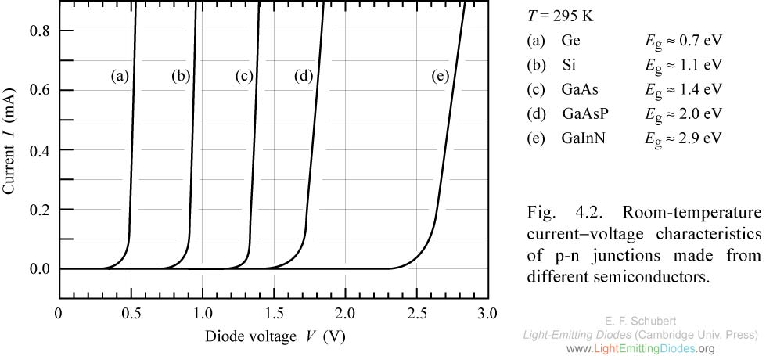
Current Vs. Voltage Characteristics
874 nm
621 nm
429 nm
Photon-emission typically starts at turn-on voltage

Slide 7
Map of the semiconductor world - Disadvantages
Image: Theory of elasticity and electric polarization effects in the group-III nitrides, Caro Bayo, Miguel Ángel

Slide 8
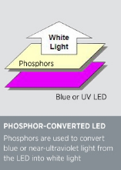
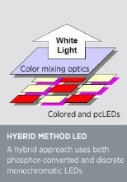
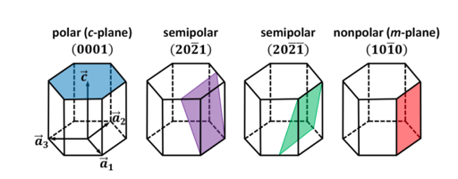
Green Easy on the eye, Hard to Produce
Indium - Nitrides
Lattice matching harder
Have substantial energy gap to produce green wavelength
Aluminum – Phosphides
Lattice matching options are easier
and more plentiful
Energy gap difficulties
Add Indium to raise energy gap
At the price of lattice mismatch
Lots of $ for research into green LED’s and Lasers!

Slide 9
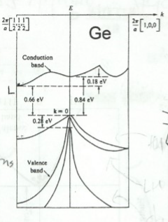
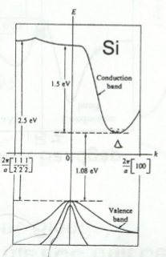
Making moves on nature’s materials game
-Ralph Dawson CHTM

Slide 10
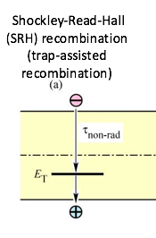
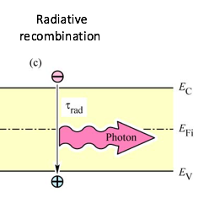
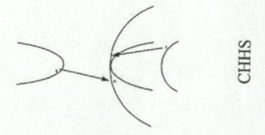
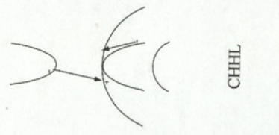
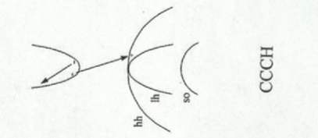
Types of electron-hole Recombination
-Ralph Dawson CHTM

Slide 11
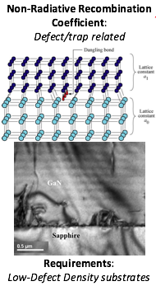
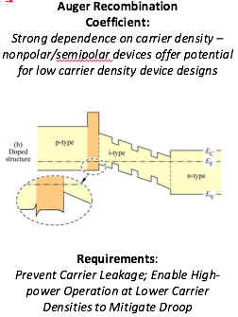
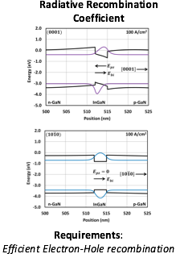
Internal Quantum Efficiency (IQE)
IQE = $\frac{Photons out of active per second}{electrons injected into LED per second}=\frac{\frac{Psp}{hv}}{I/q}$
Get rid of Shockley-Read-Hall recombination (A)
$$$ for good material
Lattice matched layers of materials
Increase B coefficient
Quantum well confinement in active
region
Direct band gap material
Auger (C)
Occurs at high current injection
Proportional to N^3
Design Energy barriers between
cladding layers and active region
Electron Blocking Layers
Doping
Composition
Thickness

Slide 12
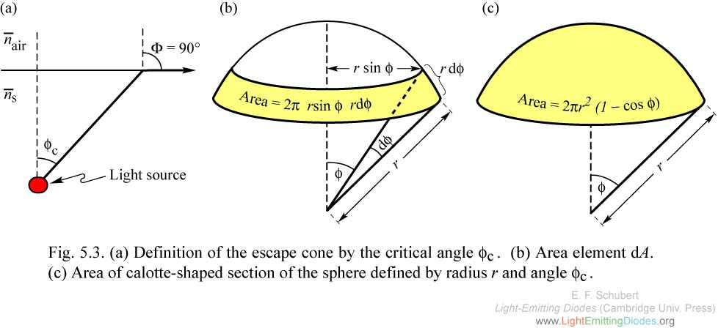
Extraction of photons
External Quantum Efficiency = $\frac{photons emitted into free space per second}{photons emitted from active region per second}=\frac{PLED/(hv)}{Psp/(hv)}$
Only a small fraction of the light generated inside an LED escapes due to total internal reflection (TIR)
The light escape cone is defined by the critical angle for total internal reflection
Trapped light is eventually absorbed by the active region, through free carriers in the substrate or cladding layers, or at the contacts
Material | Critical Angle (º) | P_{escape}/P_{source}
GaN | 23.6 | 4.18
GaAs | 17.1 | 2.21
Polymer | 41.8 | 12.7

Slide 13
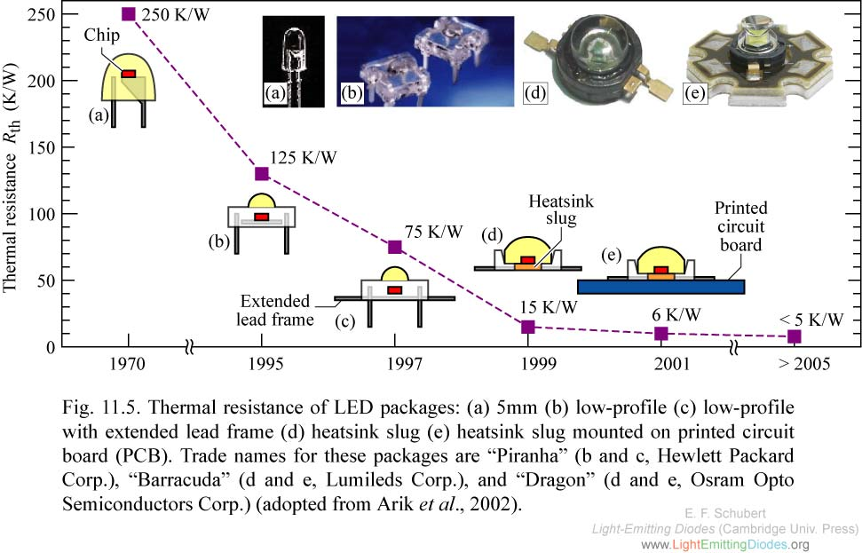
Improving External quantum Efficiency
Encapsulation
Chip shaping
Surface roughening
Absorption reduction
Electrode design
Patterned sapphire substrates
angle ~60º
⇒(1011)

Slide 14
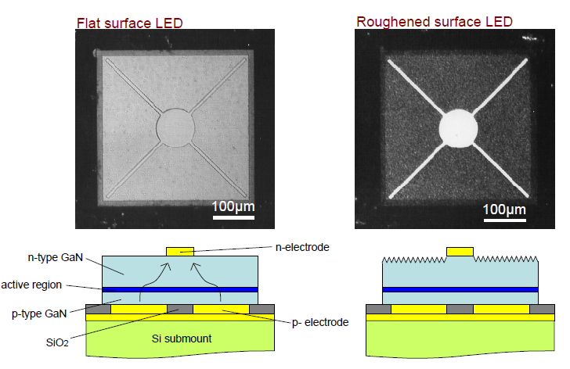
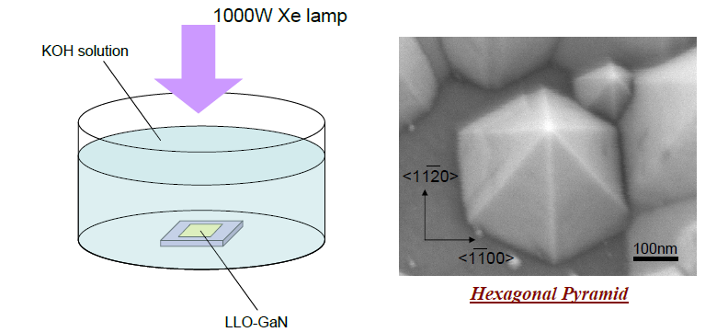
Surface Roughening
Photo electrochemical (PEC) etching
N-face GaN etches in KOH, H₃PO₄, and NHO₃ and leads to texturing
Semipolar planes serve as “stop etch layers”

Slide 15
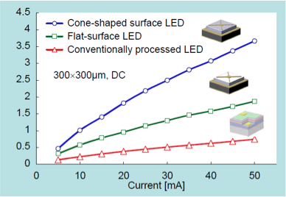
Comparison Of Efficiencies
For unpackaged LEDs, the output power is 4x higher than that of a conventionally processed LED

Slide 16
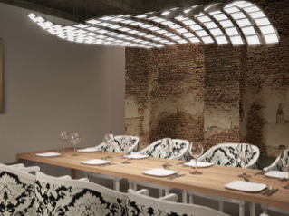
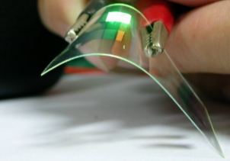
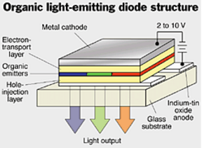
Future Technologies
OLEDs Organic Light Emitting Diodes
Provide flexible panels
Soft, diffused light
Panel is the luminaire, eliminating lamp shades, indirect lighting approaches, and other current fixture approaches.
Can be made transparent and attached to windows
Currently used in LCD backlights for some devices (phones/tablets/computers)
Currently, cost per kilo-lumen is about 20 times higher than LED ~$200/klm

Slide 17
Questions?

Slide 18
References
[1]D. Neamon, Semiconductor Physics and Devices, 4th ed. New York, NY: McGraw-Hill, 2012.
[2]L. Coldren, S. Corzine and M. Mashanovitch, Diode lasers and photonic integrated circuits. Hoboken, N.J.: Wiley, 2012.
[3]"lightemittingdiodes.org", Lightemittingdiodes.org, 2016. [Online]. Available: http://www.lightemittingdiodes.org. [Accessed: 27- Apr- 2016].
[4]R. Dawson, "Conduction Band Theory", UNM -CHTM, 2016.

